Slide 1
DentalCare Clinic
Web3 Project

Slide 2
Team
Mariam Chaker 2293t
Samar Mohsen 2141t
Mohamad Harmouch 2161t

Slide 3
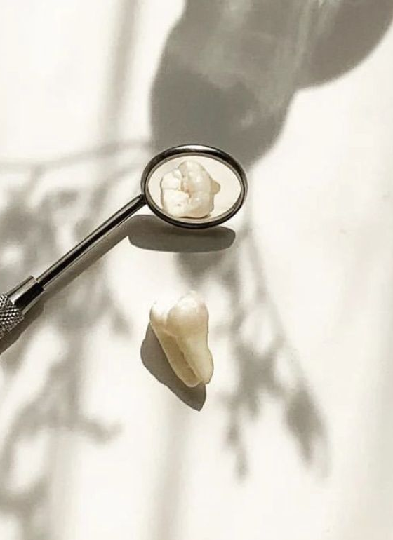
Introduction
Dentistry is an old medical profession and dentists have been attending to the patients who show up in their clinics with a diversity of problems ranging from tooth ache and wisdom tooth to tooth removal and artificial tooth replacement. The fact that most of us suffer from one or more of these teeth conditions sometime in our life makes the dentistry profession as a much sought service in society. However, the last two decades saw the diversification of this practice to include concepts that are not related to pain and teeth surgeries but to the cosmetic interventions which offer better looks and smile!
That’s why we proposed making a dental clinic website.

Slide 4
Our clinic website
Our website is made of three primary components:
The user account page,
The admin account page,
The secretary account page.
Each has a different role which we’ll discuss shortly.

Slide 5
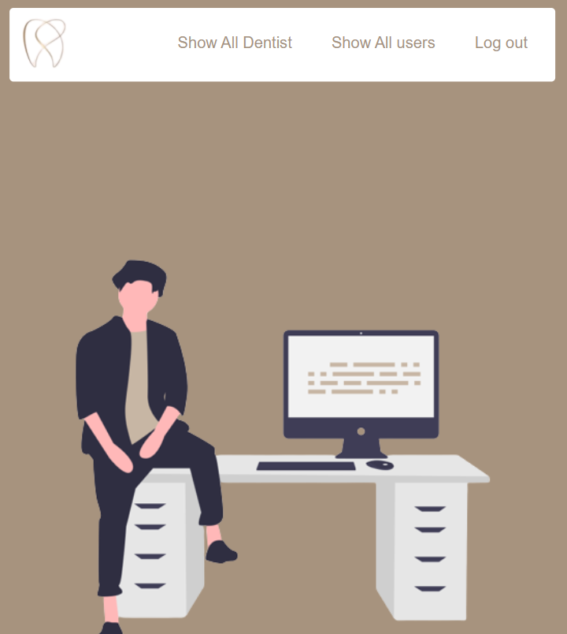
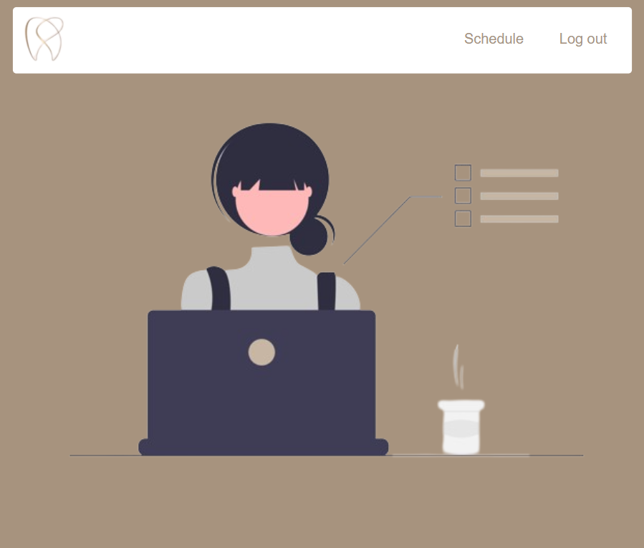
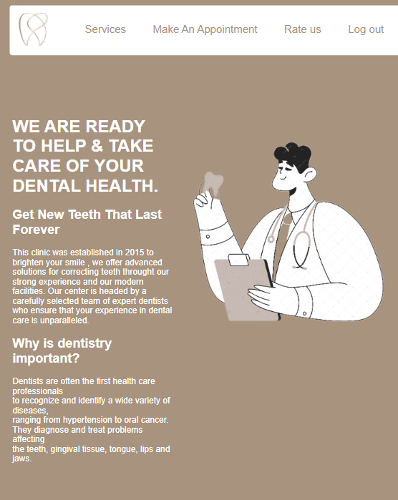
The three main pages:

Slide 6
What are the functions of each page
User
admin
Secretary
View available services
Make an appointment request
Rate the clinic and give a review
Add a dentist to the list of dentists in the clinic
View all the dentists and users and delete them if needed
Check the appointment requests and delete the unapproved ones

Slide 7
Er Diagram
appointment
Schedule_id
Date
Start_time
End_time
Service
dentist
1,1
0,n
user
Id
Name
Email
Password
Role_id
send
secretary
Id
Name
Email
Password
Role_id
0,n
1,1
recieves
0,n
Viewed/deleted
By admin
1,1
1,1
Viewed/deleted
By admin
doctor
Id
Name
Age
Department
Phone
Email
admin
Id
Name
Email
Password
Role_id
1,1
1,n
1,1
Adds/Deletes

Slide 8
thank you

